Slide 1
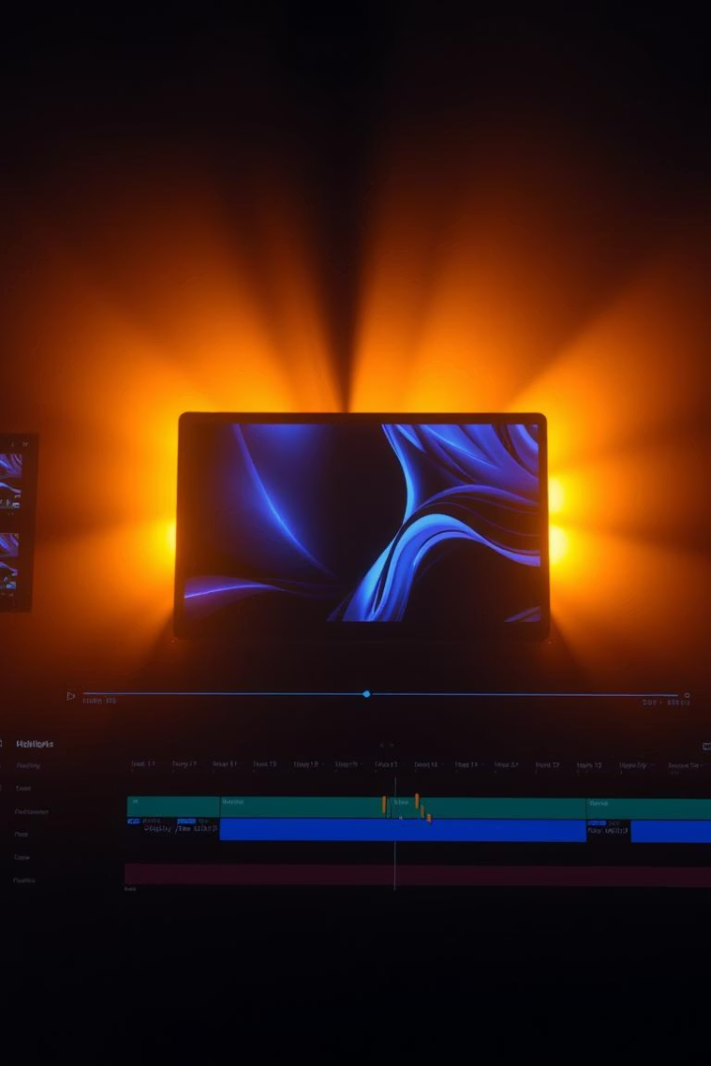
Video Highlight Generator: AI-Powered Content Optimization
In today’s fast-paced digital world, attention spans are shrinking, and content creators are under constant pressure to deliver engaging, concise videos. Traditional editing is painstakingly time-consuming, requiring hours of manual work to sift through footage, pinpoint key moments, and craft compelling highlights.
Enter AI-powered video analysis—a game-changer for creators. Leveraging advanced scene detection, audio recognition, and action tracking, this technology automates the editing process, transforming lengthy videos into captivating highlights with minimal effort. Whether it's summarizing a webinar, extracting the most exciting moments from a sports game, or creating dynamic social media clips, AI streamlines content production, saving creators time and ensuring maximum viewer engagement.

Slide 2


Meet Our Team
Siddharth Mishra
Frontend Development
Project period: Jan 2025 - May 2025
Streamlit UI implementation
Backend Processing
Video Processing & Testing
Multi-modal video analysis algorithms
FFmpeg integration and performance tuning

Slide 4
Presentation Overview
Introduction: Set expectations and highlight project goals
How It Works: Dive into system architecture and AI technologies
Performance: Showcase real-world results and improvements
Future: Outline roadmap and upcoming features
Conclusion: Summarize benefits and next steps

Slide 5
How It Works: System Architecture
Input Processing
Analysis Engine
Output Generation
Tech Stack & Metrics
Video upload and metadata extraction
Scene detection, audio and action recognition
Segment extraction and transitions
Python, OpenCV, librosa, FFmpeg, Streamlit
Temporary storage handling
Segment ranking and selection algorithms
Final video compilation
2-3 min processing per 10 min video

Slide 6
Intelligent Analysis Technologies
Scene Detection
1
Frame differencing with 92% accuracy
Audio Analysis
2
RMS energy, spectral contrast, spectral flux
Action Recognition
3
Edge detection and brightness variation
Highlight Selection
4
Custom ranking for quality and distribution
User Customization
5
Adjust settings for sensitivity and output

Slide 7

Real-World Performance
Video Length
80% average reduction
Engagement
4x higher on social platforms
User Interface
Simple upload, progress tracking, instant preview
Detection Stats
Clear display of analytics and results

Slide 8
Tech Stack Overview
This project leverages a robust and diverse technology stack tailored for efficient video highlight generation.
Python: Core programming language for implementing algorithms and orchestration.
OpenCV: Used for advanced video frame processing and scene detection.
librosa: Audio analysis library enabling extraction of sound features.
FFmpeg: Multimedia framework for video encoding, decoding, and segment extraction.
Streamlit: User interface development for an interactive and seamless experience.
Together, these tools allow automated, multi-modal video analysis and highlight generation with processing times of 2-3 minutes per 10-minute video.

Slide 9
Roadmap & Future Development
1
Advanced ML Models
Improve action detection quality
2
Cloud Processing
Handle longer videos efficiently
3
Batch Processing
Multi-video automation
4
Custom Intro/Outro
Personalized branding templates
5
Audio Enhancements
Normalization and quality boost

Slide 10
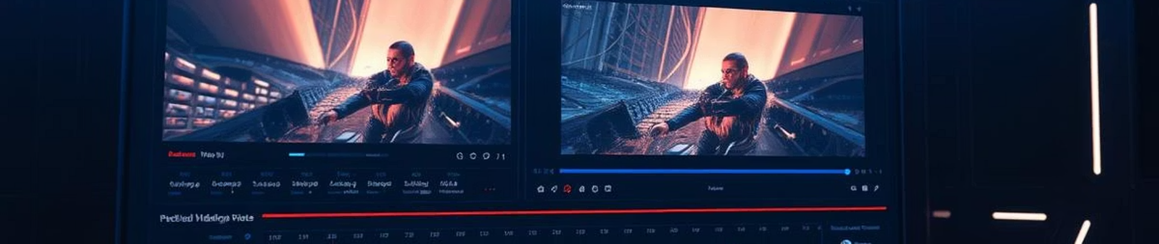
Make Video Editing Effortless with AI
Automate tedious editing, save time and boost engagement
Seamless integration with existing workflows
Scalable for creators and enterprises
Future-proof with constant AI innovation

Slide 11
Conclusion
To wrap it up, the Video Highlight Generator is a handy tool that makes video editing easier by automating the creation of highlight reels. It saves a lot of time and hassle, which is great for content creators, businesses, and anyone who needs quick edits. Whether you're a social media influencer looking for engaging clips, a sports analyst going over key moments, or a marketer showcasing products, this tool works well for different needs. Its easy-to-use interface makes it accessible for everyone, and the smart AI features, like scene detection and audio analysis, give solid results. Plus, with upcoming updates like better AI models and cloud features, this tool could really shake up the video editing world.

